Slide 1
Module 7C Innovation
Innovation Best Practices
EM680
Dr. Paul Wojnicki
School of Systems and Enterprises

Slide 2

Knowledge Objectives
Describe two major internal pressures for change.
Identify and explain six major external pressures for change
Describe the three-phase model of planned change.
Discuss important tactical choices involving the speed and style of a change effort.

Slide 3
Knowledge Objectives
POP up stores

Slide 4
Knowledge Objectives
Describe two major internal pressures for change.
Identify and explain six major external pressures for change
Describe the three-phase model of planned change.
Discuss important tactical choices involving the speed and style of a change effort.

Slide 5
Knowledge Objectives
Explain the four general causes of resistance to change and the tactics that can be used to address each cause.
Discuss the role of the DADA syndrome in organizational change.
Describe the basic organization development (OD) model and discuss OD interventions, including relationship techniques and structural techniques.

Slide 6
McKinsey Report on Innovation
Who is McKinsey?
McKinsey & Company is a private American worldwide management consulting firm headquartered in New York City. It conducts qualitative and quantitative analysis in order to evaluate management decisions. Eighty percent of the world's largest corporations are counseled by the firm, which is considered the most prestigious management consultancy.
McKinsey publishes the McKinsey Quarterly, funds the McKinsey Global Institute research organization, publishes reports on management topics, and has authored many influential books on management. Its practices of confidentiality, influence on business practices, and corporate culture have experienced a polarizing reception.
https://en.wikipedia.org/wiki/McKinsey_%26_Company

Slide 7
8 Essentials to Excel at Innovation
ASPIRE
Do you accept innovation-led growth as absolutely critical, and do you have cascaded targets that reflect this?
CHOOSE
Do you invest in a coherent, time-risk balanced portfolio of initiatives that are resourced to win?
DISCOVER
Do you have actionable and differentiated business, market, and technology insights that translate into winning value propositions?
EVOLVE Do you create new business models that provide defensible, robust, and scalable profit sources?

Slide 8
8 Essentials to Excel at Innovation
ACCELERATE
Do you beat the competition with fast and effective development and launch of innovations?
SCALE
Do you launch innovations in the relevant markets and segments at the right magnitude?
EXTEND
Do you win by creating and capitalizing on external networks?
MOBILIZE
Are your people motivated, rewarded, and organized to repeatedly innovate?

Slide 9
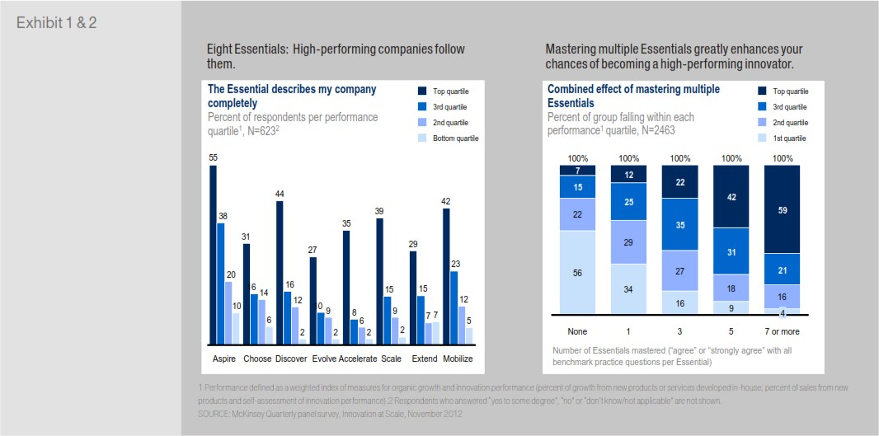
McKinsey Report on Innovation
Top innovators master multiple essentials, and with variety across essentials.

Slide 10
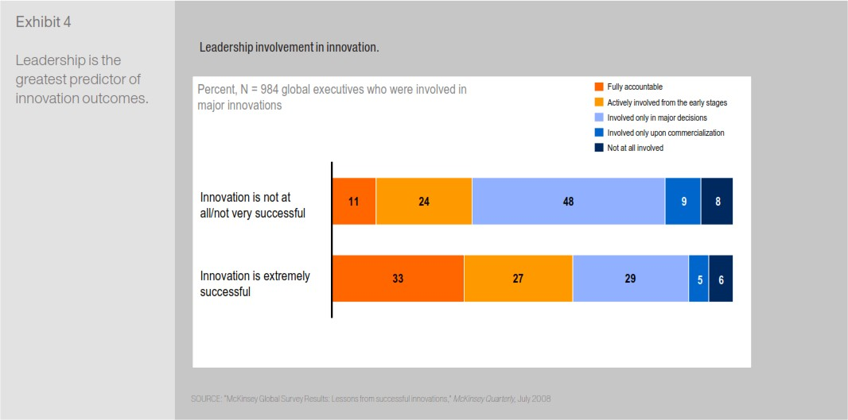
McKinsey Report on Innovation
Leadership: Envolvement = Results

Slide 11

How to: ASPIRE
Communicate an inspirational vision.
Set a clear objective for innovation-led growth.
Align leadership around the criticality of innovation.
Clear vision and strategic plan, linked to financial targets of 6 percent growth in the current core and 2 percent in new organic ventures
Innovation projects had to show how it was helping to achieve the growth targets
Increase from 4 percent annual growth to 13 percent, underpinned by the successful launch of several new brands
Became market leader in premade food only four years after entry
Notes:
Communicate an inspirational vision.
This vision should align with the strategy and the growth gap; it should be
understandable by all and should set out a clear path to enable employees to contribute. Use the opportunity to introduce a common innovation language to foster a wide dialogue and facilitate joint learning and sharing.
Set a clear objective for innovation-led growth.
Quantify the vision into an unambiguous goal that sets the amount of innovation required to meet your overall performance goals. This innovation goal must be substantial to prompt action. If there is no gap, you may want to revisit business goals. Determine if your current innovation investments are substantial enough to fill the growth gap. Be sure to account for failing or underperforming innovation investments, which many companies unknowingly overlook.
Align leadership around the criticality of innovation.
Secure a commitment from senior leaders that they will take action. Allocate targets for growth from innovation to business units. Include these targets in strategic planning and budgeting, as well as in performance appraisals. Translate the allocated targets per business unit in the right mix of financial
and nonfinancial metrics and cascade them throughout theorganization.

Slide 12

How to: CHOOSE
Make sure you are clear on the innovation themes you are pursuing.
Align the portfolio of innovation projects with corporate financial objectives and business strategy.
Make sure your initiatives are resourced to win
Create a portfolio governance system.
Balance between breakthrough and incremental innovation investments.
Senior management asks high-potential leaders to submit at least three “Imagination Breakthrough” proposals each year.
120 such projects, generating an estimated $3 billion in annual revenues.
Notes:
1. Make sure you are clear on the innovation themes you are pursuing. A combination of market intelligence and
scenario analysis will yield a selection of innovation themes. Invest in these through R&D, capability-building initiatives,
and business-development bets. Conduct disciplined ongoing reviews of these choices and allocations.
2. Align the portfolio of innovation projects with corporate financial objectives and business strategy.
Comb the enterprise to find out what people are doing. Then map the innovation pipeline into a portfolio matrix using
proven metrics—the anticipated size of the opportunity, the associated risk, and the probability of success within a defined
time frame. Ensure that the set of projects and the investment allocated to them reflect the business’s belief about where the
most significant growth opportunities are. Management must be quite confident that the portfolio will deliver on financial
performance targets.
3. Make sure your initiatives are resourced to win. This entails investing enough in innovation to achieve your targets.
Particular care should be taken to resource breakthrough innovation initiatives enough to win against both current
and future competition, and to ensure adequate funding to mat urit y.
4. Create a portfolio governance system. High-risk,high-return initiatives should be managed differently than
incremental, low-risk projects. The two require different levels of attention. Management must have a routine to discuss and
debate the portfolio, as well as a way to aggressively weed out low-value, low-priority projects and reallocate resources to
opportunities that are of higher value.
How have others done it?
General Electric is a global conglomerate with a diverse set
of solutions in energy, health and home, transportation and
finance. GE actively manages its innovation portfolio to ensure
an adequate balance between breakthrough and incremental
innovation investments. While each business unit defines and
manages its own innovation portfolio within the realm of its
scope, combined corporate and business-unit-level teams assess
potential additional innovation investments. Where exciting
innovation opportunities are identified, senior management
asks high-potential leaders to submit at least three “Imagination
Breakthrough” proposals each year. These ideas must expand
business into a new category, geography, or set of customers. GE
has funded more than 120 such projects, generating an estimated
$3 billion in annual revenues.

Slide 13
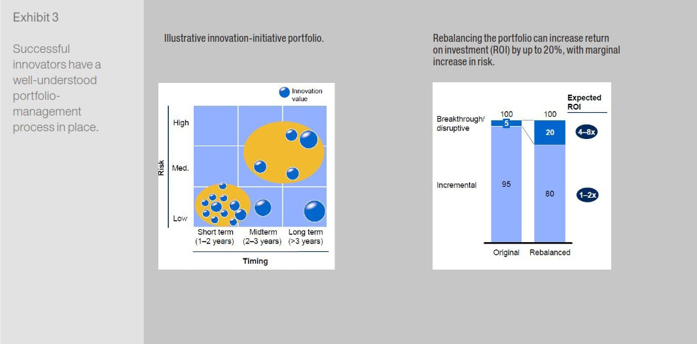
McKinsey Report on Innovation
Successful innovators manage portfolio of innovation.

Slide 14

How to: DISCOVER
Systemically scan for opportunities using multiple lenses: Business Lens, Market Lens, Technology Lens
Synthesize information into insight and describe specific problems to solve
Create differentiated value propositions
Driving innovation derived from consumer insights that identify and address needs through investment in in market research
R&D programs not just on technology, but on technology that has clear benefits which align with those consumer needs
Every year, P&G lists the top unmet consumer needs for each business and the company overall and builds its innovation strategy around them.
Adjacent new solutions: Leverage brands to expand (Pampers expanded into wipes and changing pads and Crest into other “healthy mouth” products like white strips.)
Consumer-learning tools, for instance benefiting from crowdsourcing insight via digital platforms such as Vocalpoint to connect with an “army of moms” (Vocalpoint has 250,000 members) for insights on products
Notes:
How to discover
1. Systemically scan for opportunities using multiple lenses. For customer or consumer needs, use a range of
qualitative evidence such as in-context observations and ethnographic research, together with quantitative surveys to
describe the motivation behind purchases of certain products and services, and to see how these are used. Great insight must
go beyond known needs and pain points. Examine existing and emerging technologies and focus on the benefits they can offer.
Consider the business dynamics in and around your category and the market position within your category. Ask, for example,
what innovation opportunities would be possible if your value chain were redesigned with the end customer in mind? How
could you dramatically save your customer time or improve his or her economics?
2. Synthesize information into insight and describe specific problems to solve. Use teams with members from
different disciplines to interpret the data and develop a concise list of the activities and outcomes that customers hope to
achieve. Assess the relative importance of their desires, wishes, and wants. Scan existing solutions, no matter how simplistic
they may appear. Judge how well the current solutions address customers’ stated and unarticulated preferences.
3. Create differentiated value propositions. Any new value proposition should identify who the target is, what problem is
being solved, and how a company will make money over time, given anticipated competition. World-class innovators have
systematic approaches to gaining this unique level of insight and translating it into valuable new propositions that are
clearly differentiated from those of the competition.

Slide 15

How to: EVOLVE
Develop market intelligence and explore possibilities
Selectively invest in a diversified set of initiatives to explore innovative business models
Continuously re-evaluate your position in the value chain
Consider business models that you can use to deliver value to priority groups of new customers
Retail remains Amazon’s core business, but the company has evolved services
AWS (Amazon Web Services) now accounts for 20% of revenue and large percent of profit.
Amazon uses its operating infrastructureand supply chain to create new businesses, ranging from hosted computing services, Amazon Fresh and Warehousing/fulfillment.
Video and Audio streaming evolved from sales. Now Amazon produces Original Content to supplement its video services., Amazon Video, Hardware etc.
Notes:
How to evolve
1. Develop market intelligence and explore possibilities.
Many companies set up a special team to collect and analyze
marketing information in order to separate the noise from
the signal and so derive implications. Another team may
investigate new technologies that have the potential to change
the industry business model. Regularly review this intelligence
with senior management, actively discuss and debate lessons
learned, and incorporate the implications.
2. Selectively invest in a diversified set of initiatives to
explore innovative business models. Establish focused
cross-functional teams charged with developing successful
pilots into sizable businesses. Set widely understandable and
accepted metrics to measure performance and learn from
market experiences. Ensure that you have an effective funding
model in place for new businesses that do not currently fit into
your structure.
3. Continuously re-evaluate your position in the value
chain. Explore market signals and separate trivial shifts from
those that are truly disruptive. Map the ways your business
could develop, paying close attention to the factors that will
change quickly and those that will only change slowly. Develop
an understanding of the impact of the different scenarios on
your business, paying attention to the evolution of critical
technologies and the likelihood of business-model disruptions.
4. Consider business models that you can use to deliver
value to priority groups of new customers. Do not get
locked into a narrow conception of your business model—have
the confidence to explore broader opportunities. Always be on
the look-out for new profit pools. Explore potential delivery
model changes and new customer groups. Pilot projects and
experimentation will help you make smart decisions about
where your resources can be allocated efficiently; stress-test
resulting new value propositions against counter moves by
competitors.

Slide 16
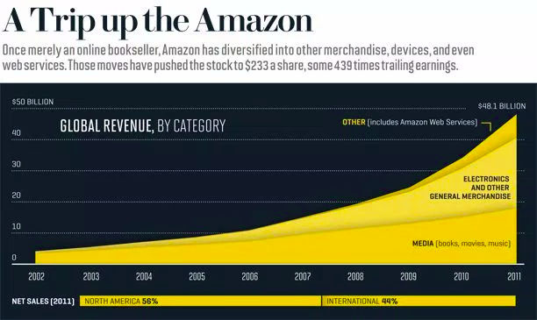
How to: EVOLVE

Slide 17



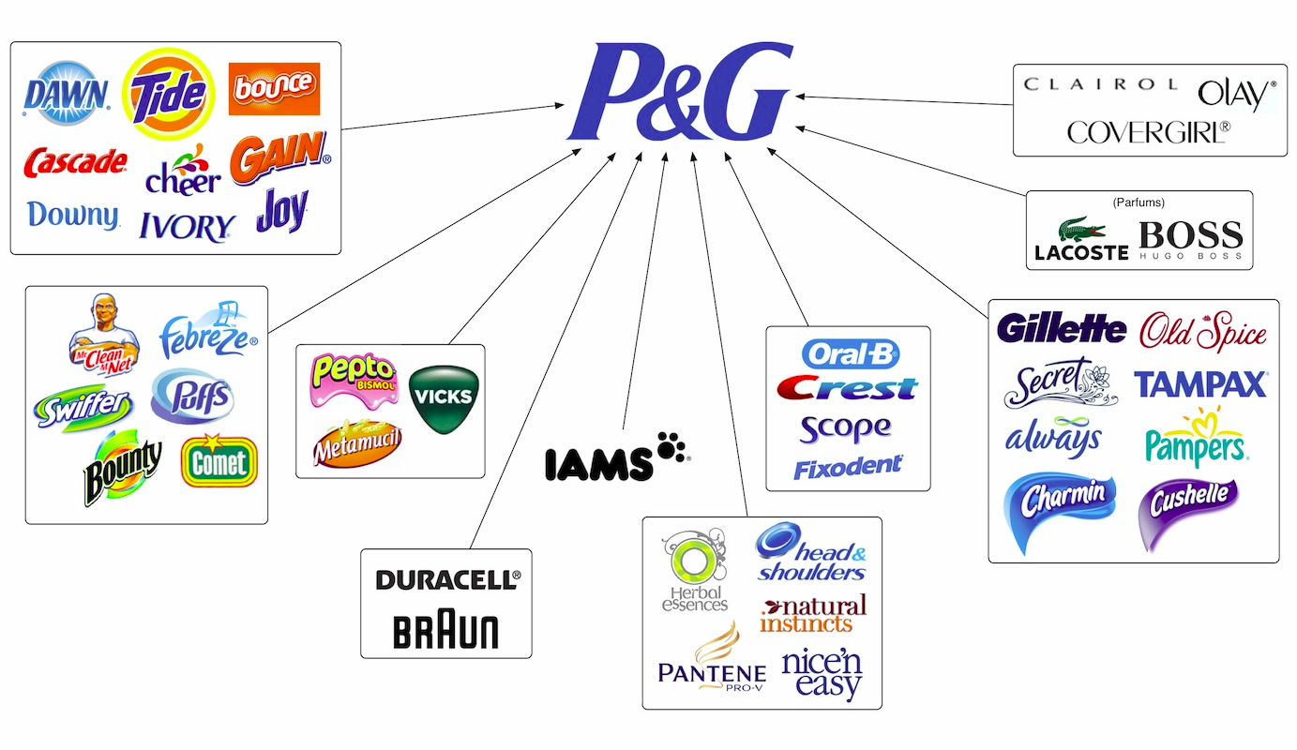

Types of Innovators – Essentials Needed
VISIONARY INNOVATORS Companies driven by a strong leader who sees the paradigm shift earlier than anyone else: Steve Jobs/Apple Critical Essentials: Aspire & Scale
STRATEGIC INNOVATORS Right place, at the right time – Samsung, with the right portfolio. Critical Essentials: Choose & Evolve
DISCOVERERS Identifying offerings to fulfill hidden customer needs. P&G and J&J Critical Essentials: Discover & Scale.

Slide 18



Types of Innovators – Essentials Needed
FAST FOLLOWERS Out-deliver innovation to market, even if they are not the first to come up with the idea. Speed to marker is backed up with size in delivery. Critical Essentials: Accelerate, Scale & Mobilize
EXPERIMENTERS Explore a high number of avenues within their broad chosen areas. Encourage hundreds (if not thousands) of flowers to bloom. Google, Facebook. Critical Essentials: Mobilize & Choose

